Slide 1

SECURITY ANALYTICS
TEAM 8
RIJISH GANGULY
SIBORA SERANAJ
Project Manager – Susan Jacobs

Slide 2


Background
1.5 billion malicious connection attempts per day on the Duke network
One untapped area is research into the types of attacks and learning how universities are targeted.
Deploy Honeypots with sensors to collect data in order to recognize patterns and build a statistical model

Slide 3


A honeypot is a network-attached system set up as a decoy to lure cyberattackers and to detect, deflect or study patterns of hacking attempts (in order to gain unauthorized access to information systems.)

Slide 4

“The goal of the STINGAR project is to enable low friction generation of threat intelligence, data sharing, and action on threat intelligence for the higher education community”
Duke IT has partnered with several partner schools who have agreed to deploy this system and share data

Slide 5
THINGS to Explore
1. Differences between attacks on cloud and local honeypots
2. Patterns in evolution of attacks over time, at indicator level and sensor level
4. See if indicators return after being blocked
5.Make inferences from geographical data
3. Attack classification based on distribution of number of connections, number of sensors hit, usernames, password tried and urls used

Slide 6
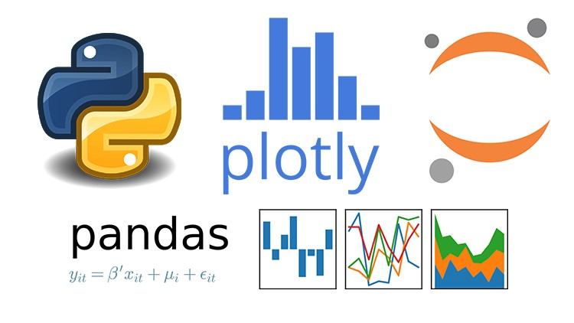





Slide 7
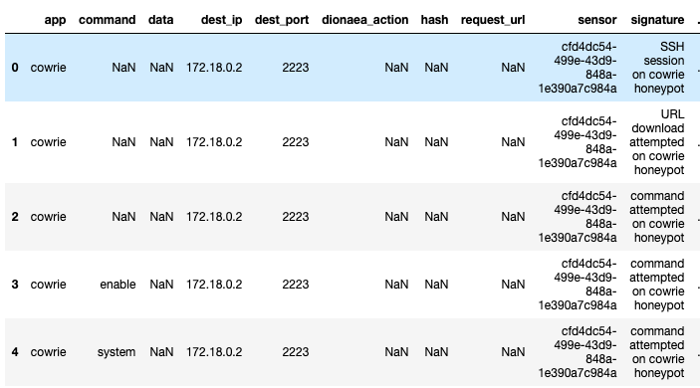
DATA

Slide 8
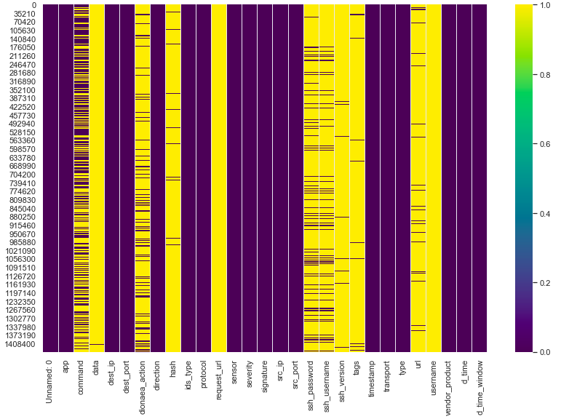
Challenges

Slide 9
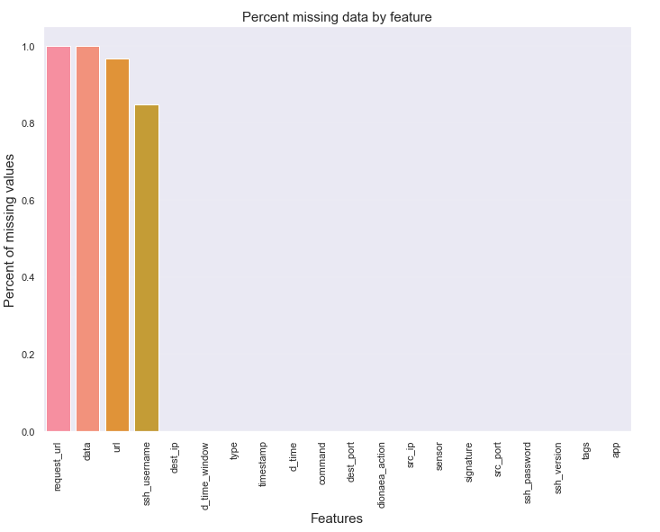
Challenges

Slide 10
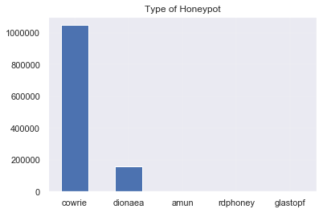
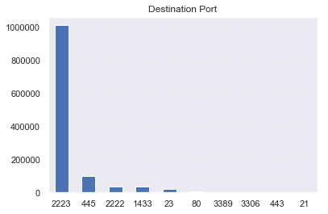
DATA
VISUALIZATION

Slide 11
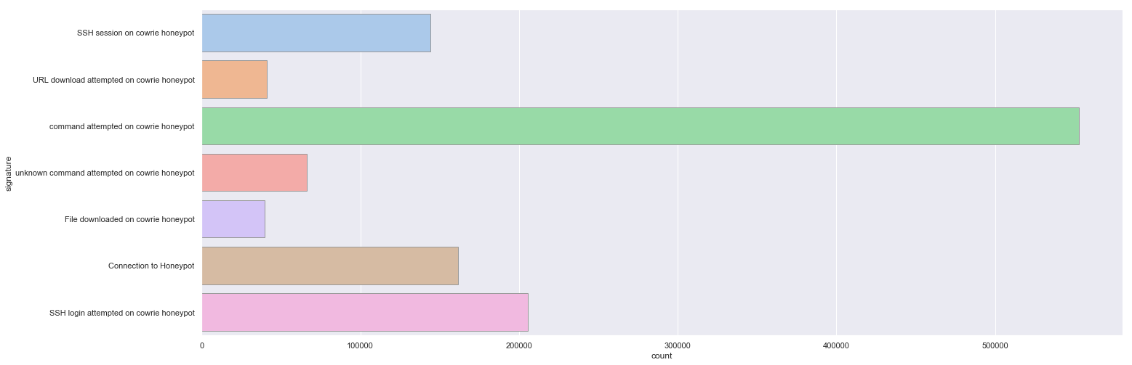
Attack Signature
SSH session on cowrie honeypot
URL download attempted on cowrie honeypot
Command attempted on cowrie honeypot
Unknown command attempted on cowrie honeypot
File downloaded on cowrie honeypot
Connection to honeypot
SSH login on cowrie honeypot

Slide 12
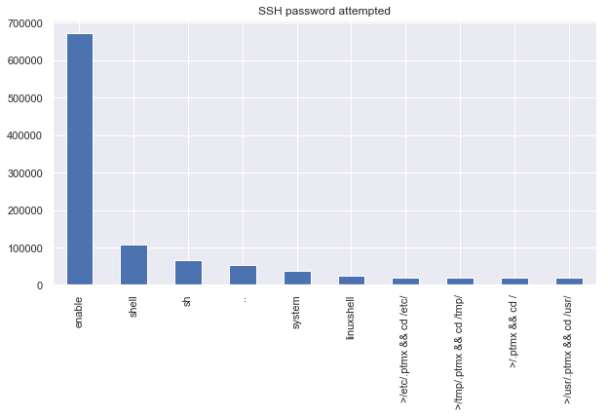

Slide 13
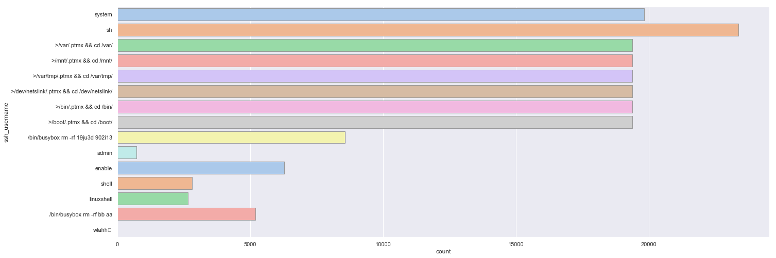
SSH username attempted
system
sh
>/var/.ptmx && cd /var/
>/mnt/.ptmx && cd /mnt/
>/var/tmp/.ptmx && cd/var/tmp/
>/dev/netslink/.ptmx && cd /dev/ netslink/
>/bin/.ptmx && cd /bin/
>/boot/.ptmx && cd /boot/
>/bin/busybox rm –rf 19ju3d 920i13
admin
enable
shell
linuxshell
/bin/busybox rm –rf bb aa
wlahh

Slide 14


Inference from geographical data
Limitations:
Attackers may alter their IP address
General Idea:
Use attacker’s IP to locate the country of attack
Find the population for each country and the percentage of people with internet access
Calculate the Rate of Attacks per Internet User

Slide 15
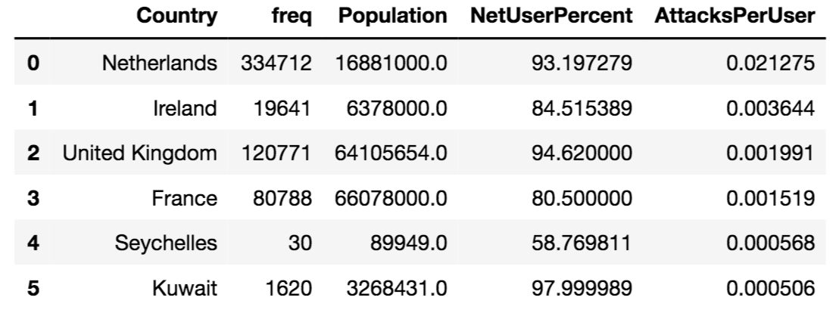
DATA

Slide 16
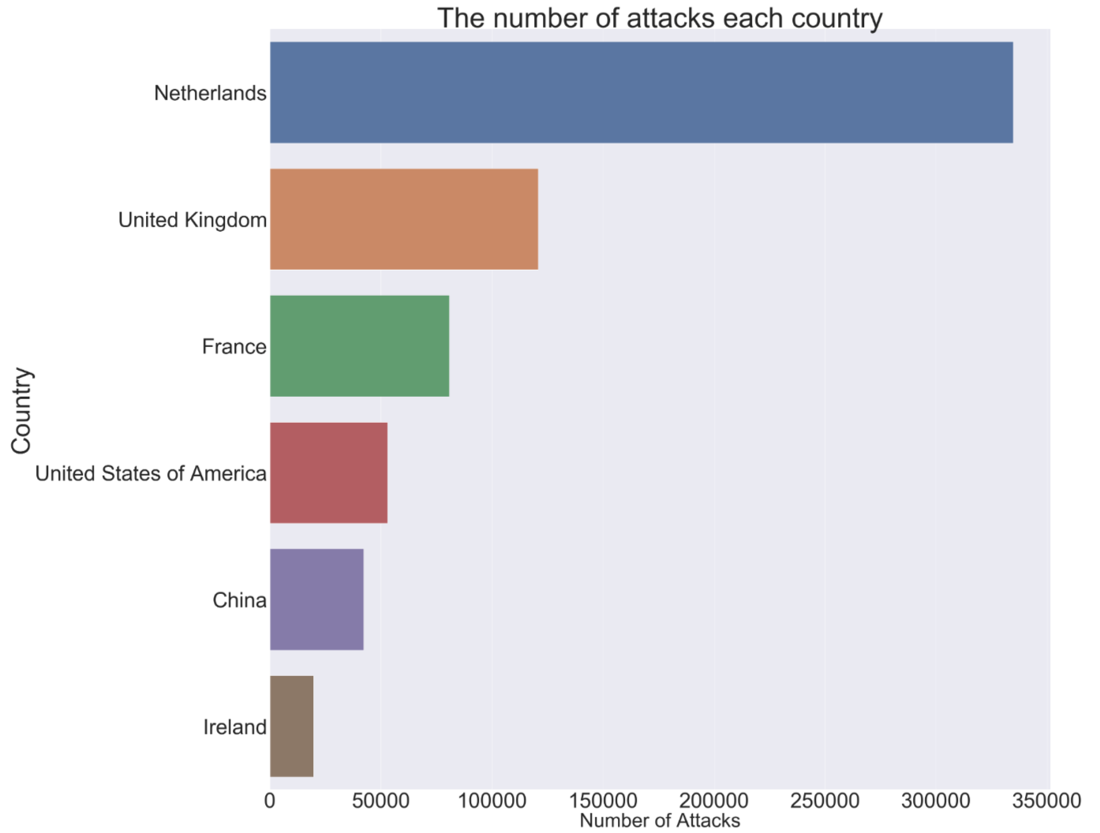
The number of attacks in each country
NUMBER OF ATTACKS

Slide 17
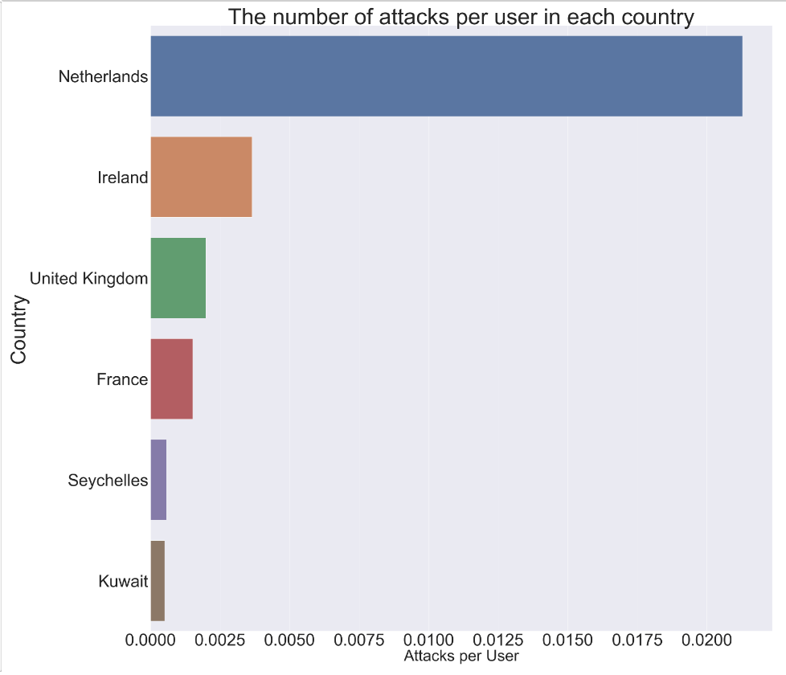
NUMBER OF ATTACKS PER USER

Slide 18
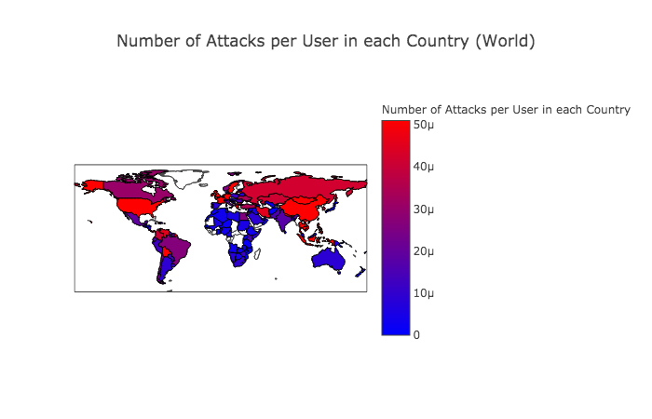

Slide 19
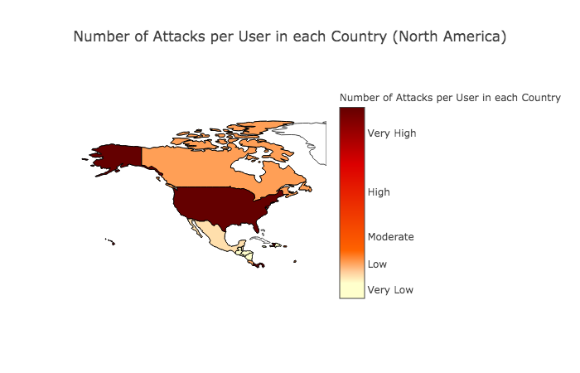

Slide 20
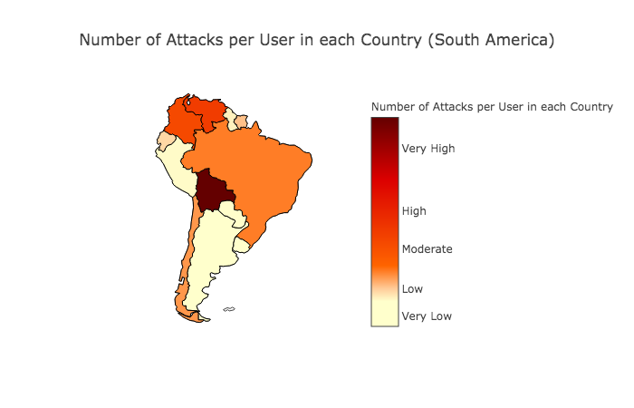

Slide 21
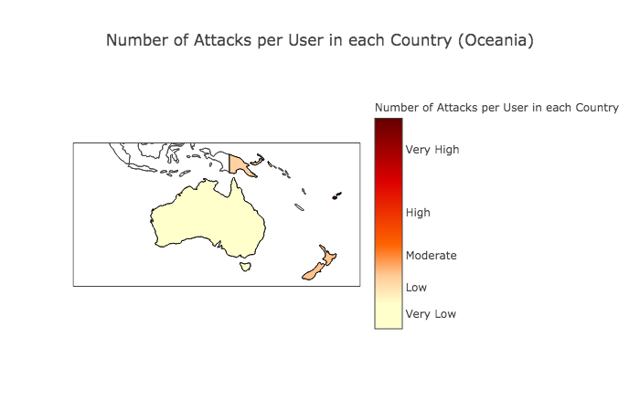

Slide 22
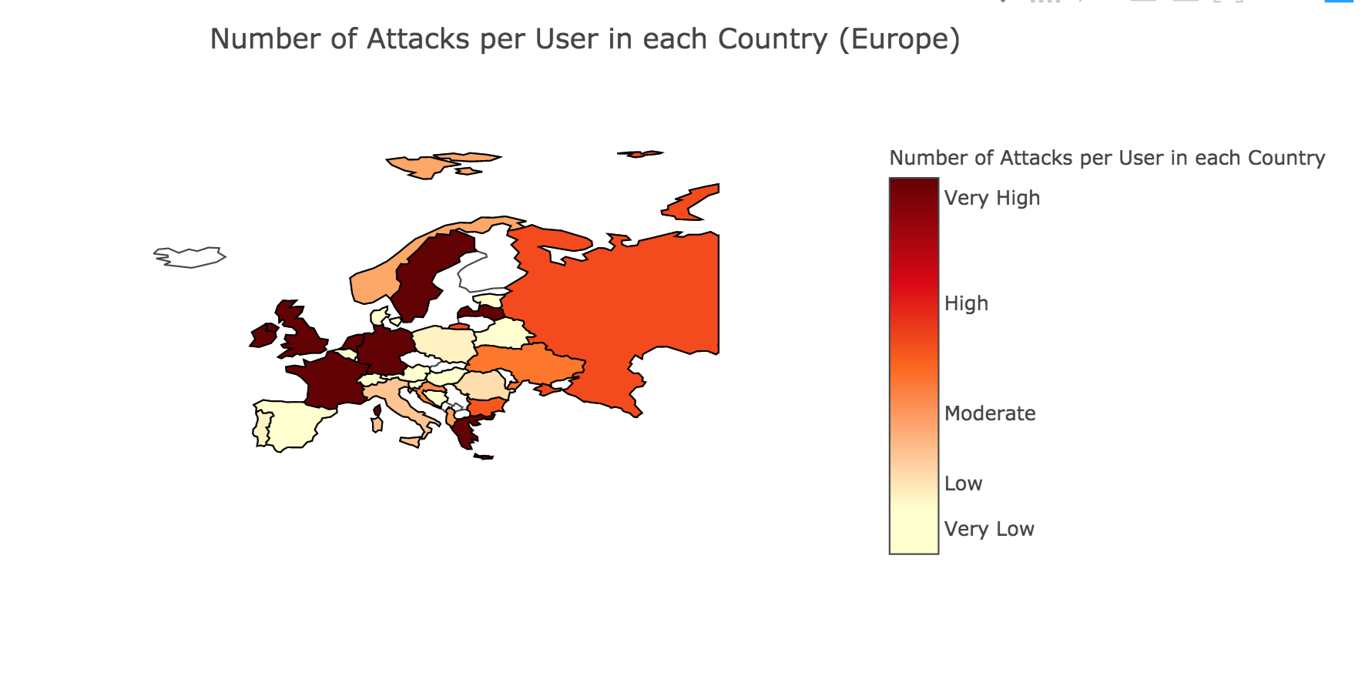

Slide 23
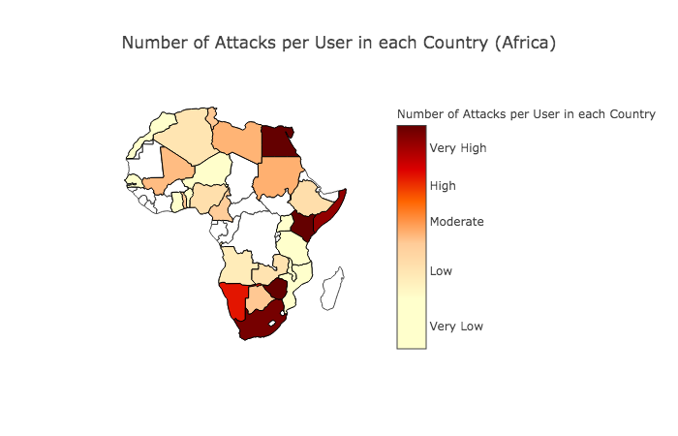

Slide 24
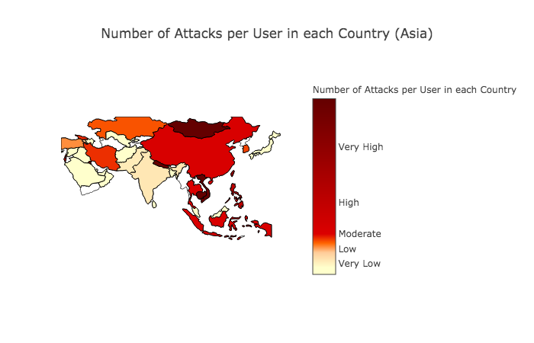

Slide 25
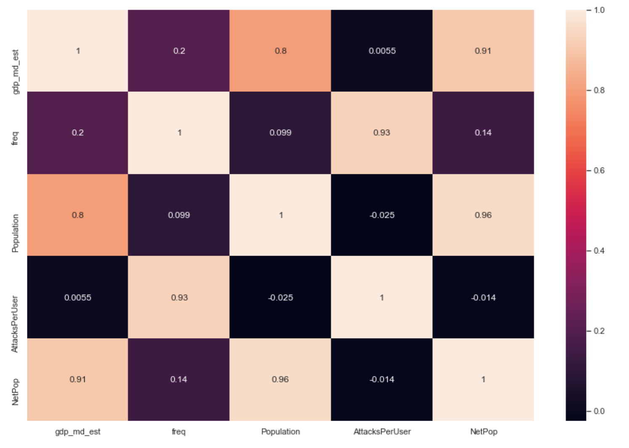
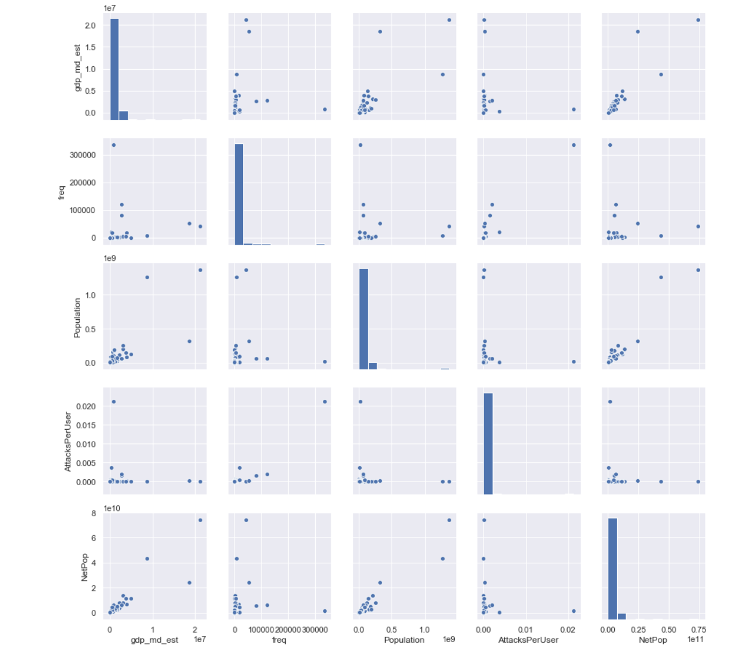
Modelling Attempt
Correlation between variables
Pair plot

Slide 26
Linear Regression Model
Frequency of attack as y variable
The features used were – GDP, Population, Attacks per user and Population with access to the internet
The Linear Regression Model was statistically insignificant
Mean Absolute Error - 2073.2054110298554
Mean Squared Error - 13059894.863763131
Root Mean Squared Error - 3613.84765364606

Slide 27
Feature Engineering
Feature engineering is the process of using domain knowledge of the data to create features that make machine learning algorithms work.
A feature is an attribute or property shared by all of the independent units on which analysis or prediction is to be done. Any attribute could be a feature, as long as it is useful to the model
According to Marcin Nawrocki et al (2016), IP, Port, Attack frequency, time until first attack, number of sources per attack, session duration and time between sessions are a few features that can be useful for honeypot data analysis

Slide 28

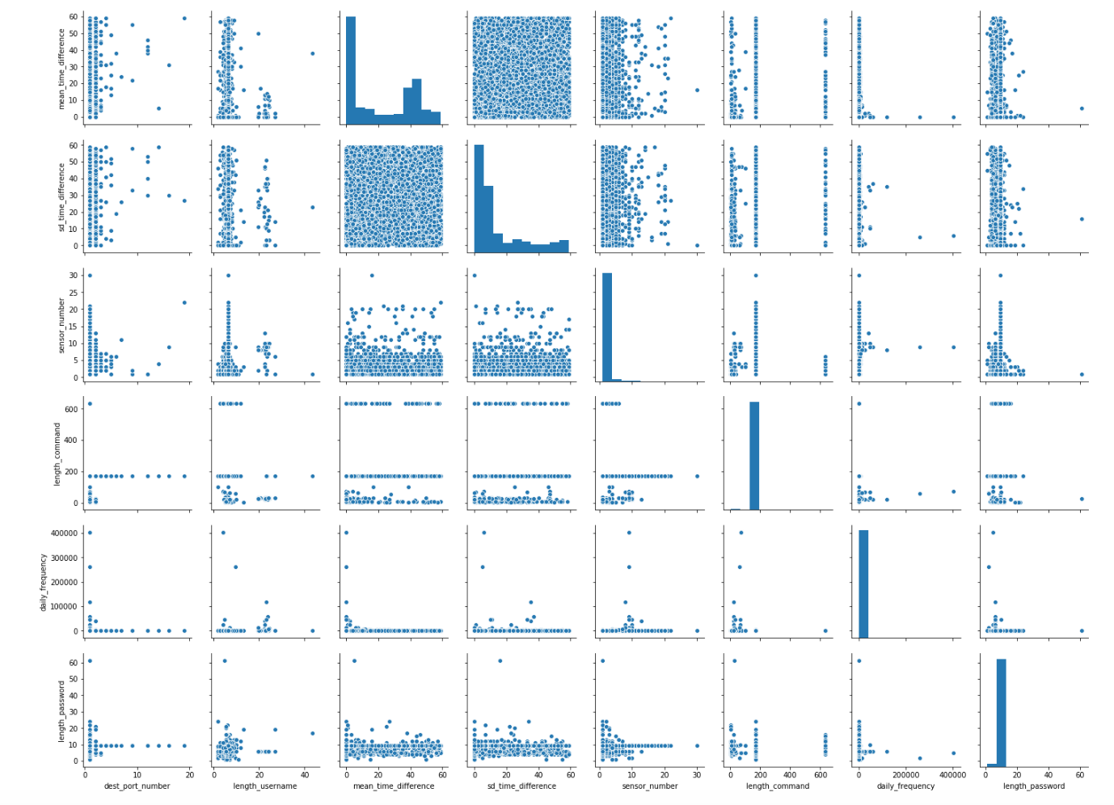



Feature Engineering
mean_time_difference is the mean difference in time between two consecutive attacks from the same IP
sd_time_difference shows the standard deviation of time difference between two consecutive attacks from the same IP
sensor_number is the number of distinct sensors hit by a particular attacker
daily_frequency is the number of attacks from a particular IP address

Slide 29
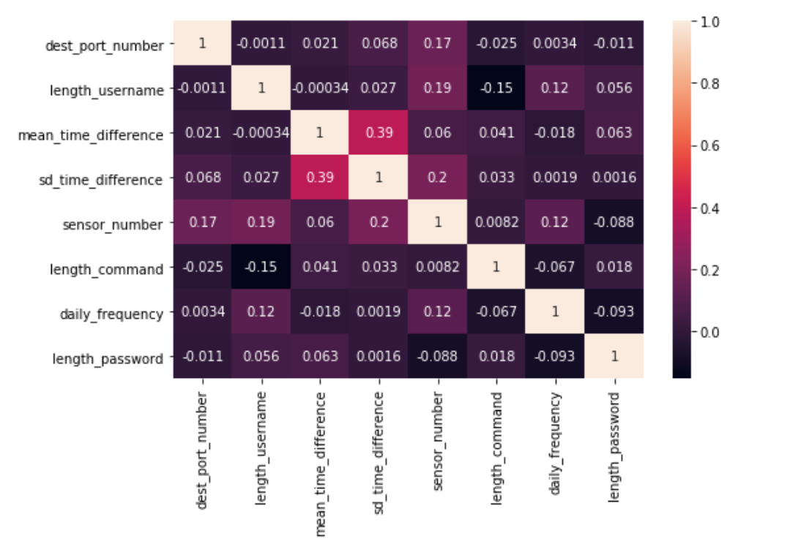
length_username is the length of the username-input from a particular I
length_password is the length of the password input by the attacker
length_command is the length of the command run by the attacker if they are able to login

Slide 30
K-MEANS CLUSTERING
The K-Means algorithm belongs to the category of prototype-based clustering.
Each cluster is represented by a prototype, which can either be the centroid (average) or the medoid (the most representative or most frequently occurring point)
One of the drawbacks of this clustering algorithm is that we have to specify the number of clusters, k, a priori.

Slide 31

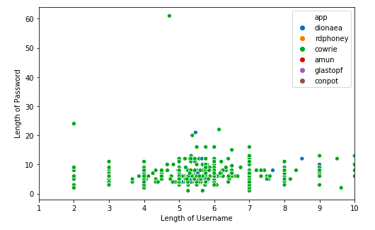
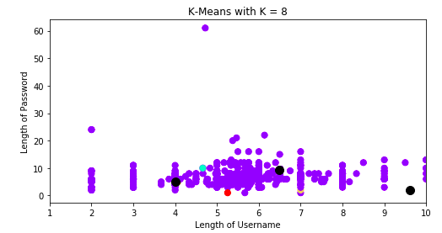
Clustering based on Honeypot

Slide 32
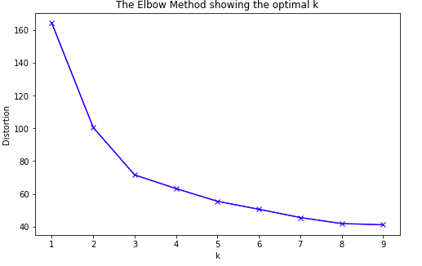
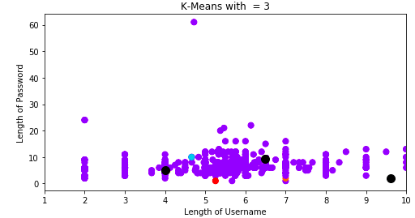
Elbow-Method
The idea of the elbow method is to run K-Means clustering on the dataset for a range of values of k and for each value of k calculate the sum of squared errors (SSE). We choose the k value for which we see the largest drop in distortions

Slide 33
K-Nearest Neighbors
The KNN algorithm assumes that similar things exist in close proximity.
In the classification phase, k is a user-defined constant, and an unlabeled vector is classified by assigning the label which is most frequent among the k training samples nearest to that query point.
Choosing the right value of k is a process called parameter tuning, and is important for better accuracy.

Slide 34
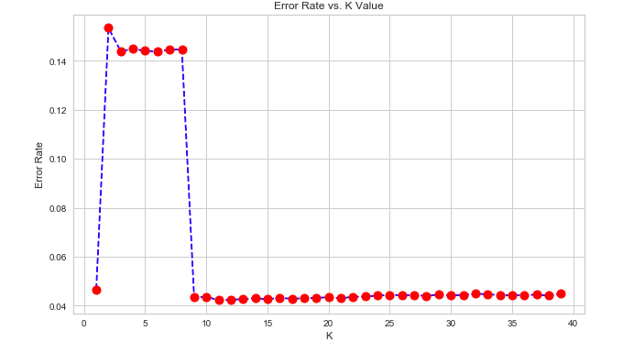
K-Nearest Neighbors for Classification
Our objective was to classify the type of honeypot – Cowrie or Dionaea based on the features we generated
Cowrie was assigned 0 and Dionaea was assigned 1

Slide 35
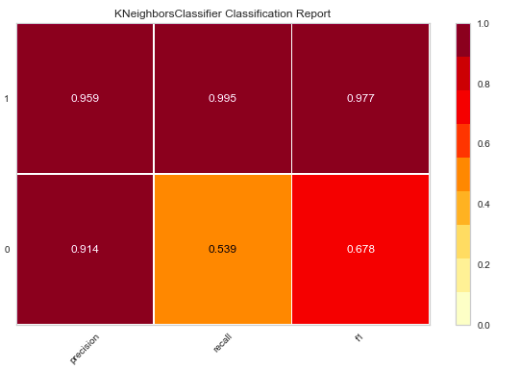
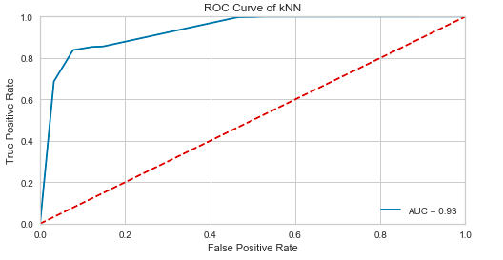
Classification Results

Slide 36
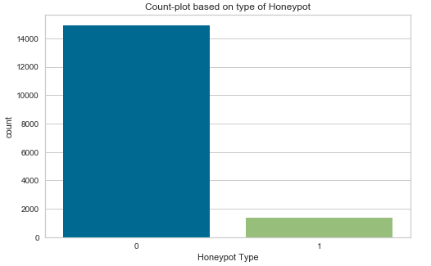
Logistic Regression for Classification
Logistic regression is a statistical model that uses a logistic function to model a binary dependent variable
Our objective was to classify the honeypots based on whether they were cloud-based or local honeypots
Cloud was assigned 0 and Local was assigned 1

Slide 37
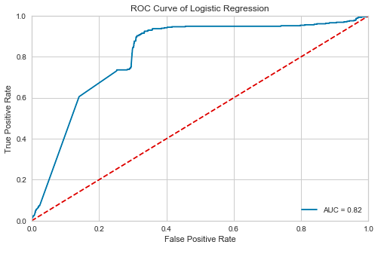
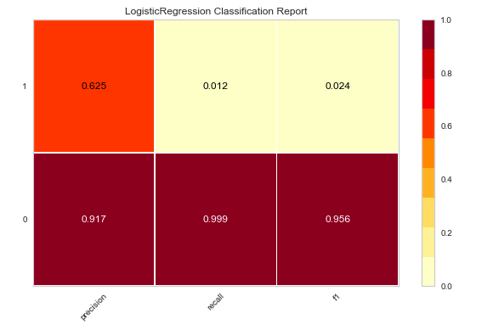
Classification Results

Slide 38
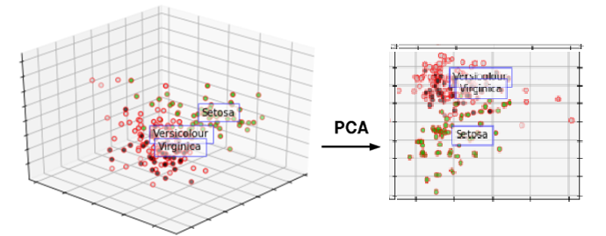
PRINCIPAL COMPONENT ANALYSIS
It is difficult to visualize high dimensional data
PCA orthogonally transforms many possibly correlated numerical variables into a specified number of linearly uncorrelated variables.
These variables are called principal components.

Slide 39
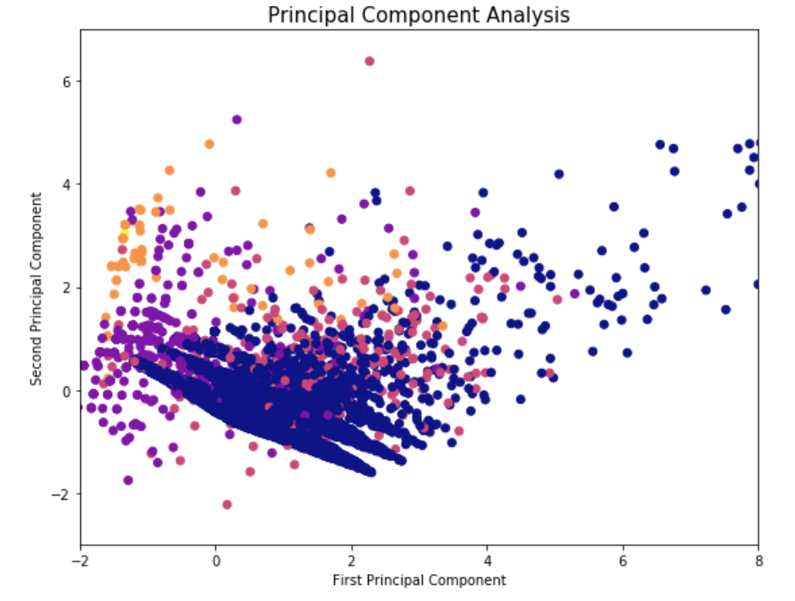
PCA – all honeypots
Our first attempt was analysis on all honeypots based on attack signatures
Very distinct clustering on one signature
Scattered overall
Next step: Analysis on only Dionaea honeypots

Slide 40
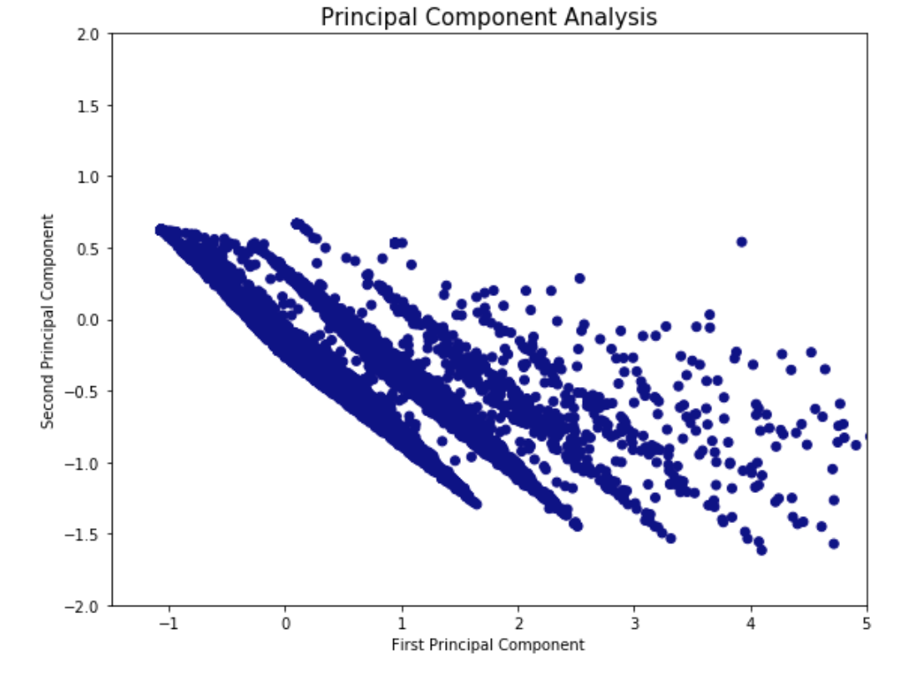
PCA – Dionaea
Distinct clusters
Surprisingly all of the same signature
Dimensionality is still high, only 2 components visualized here

Slide 41
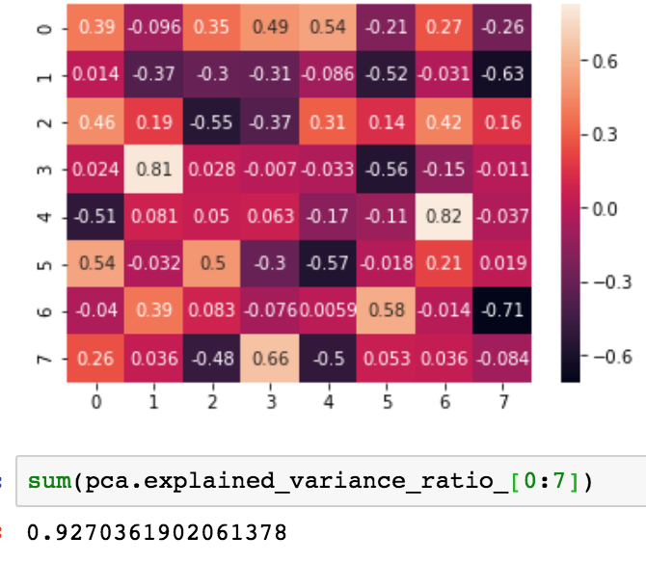
7 components explain around 93% of the variation in the data
6 components explain around 85% of the variation in the data
2 components explain around 37% of the variation in the data

Slide 42

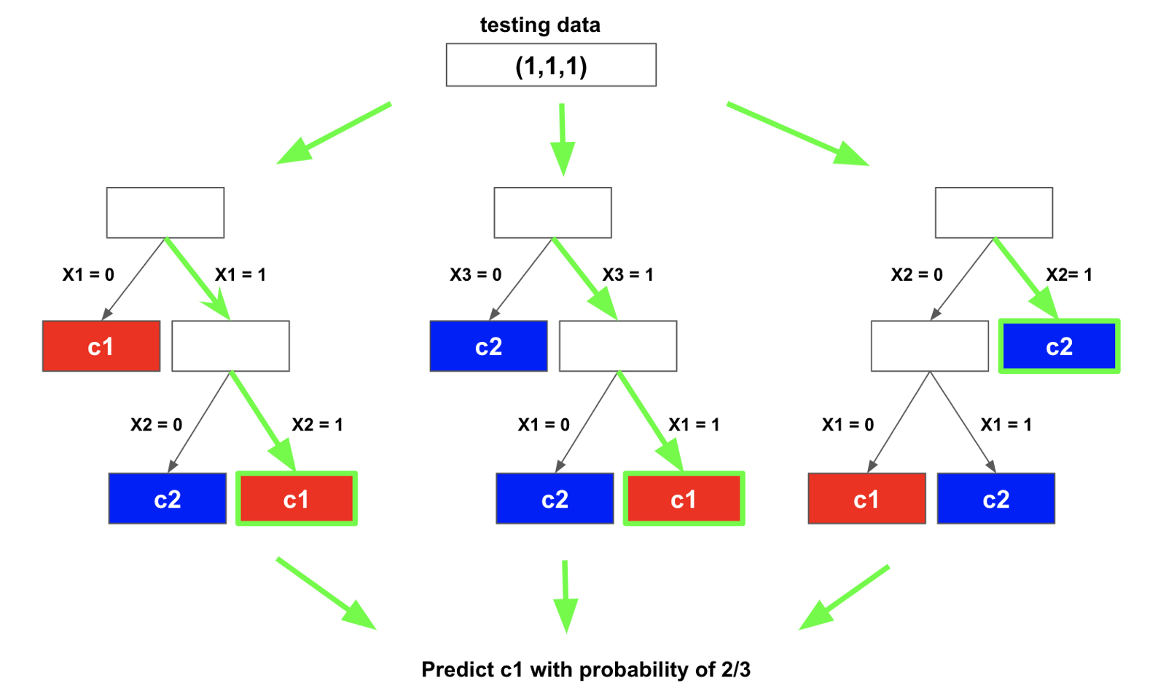
Random Forest Classification
Random forests are an ensemble learning method for classification and regression.
Constructs a multitude of decision trees at training time and outputs the class that is the mode of the classes
Random decision forests correct for decision trees' habit of overfitting to their training set.

Slide 43
Variable importance
To measure the importance of a feature after training, the values of that feature is permuted among the training data and the out-of-bag error is again computed.
The variable importance score for this feature is computed by averaging the difference in out-of-bag error before and after the permutation over all trees
Features with higher scores are more important
In our case:
1. mean_time_difference,
2. sd_time_difference
3. daily_frequency
were the most important features for prediction

Slide 44
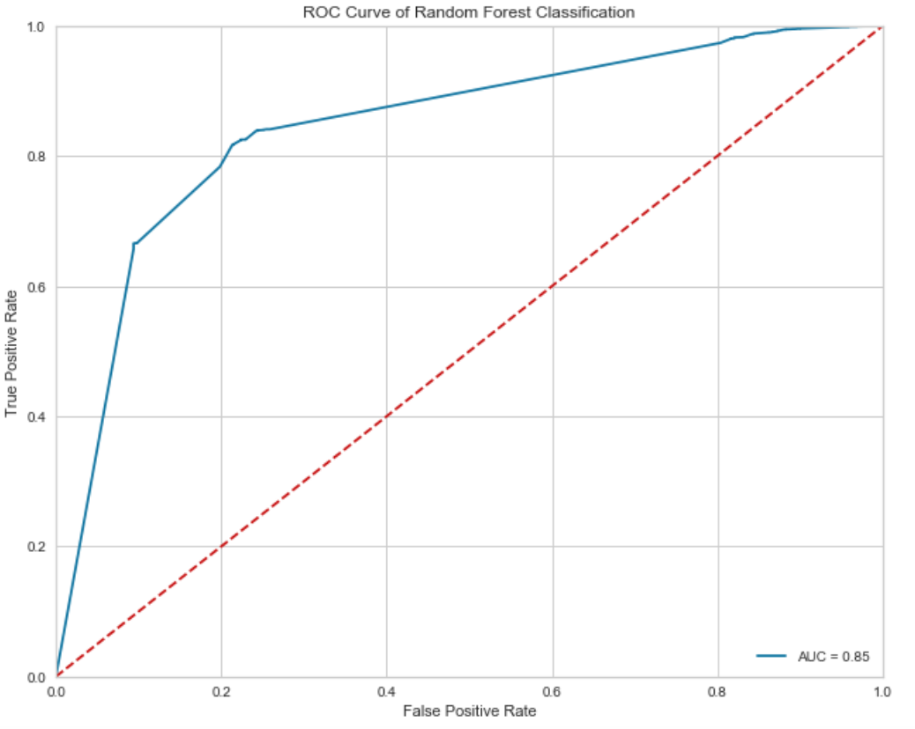
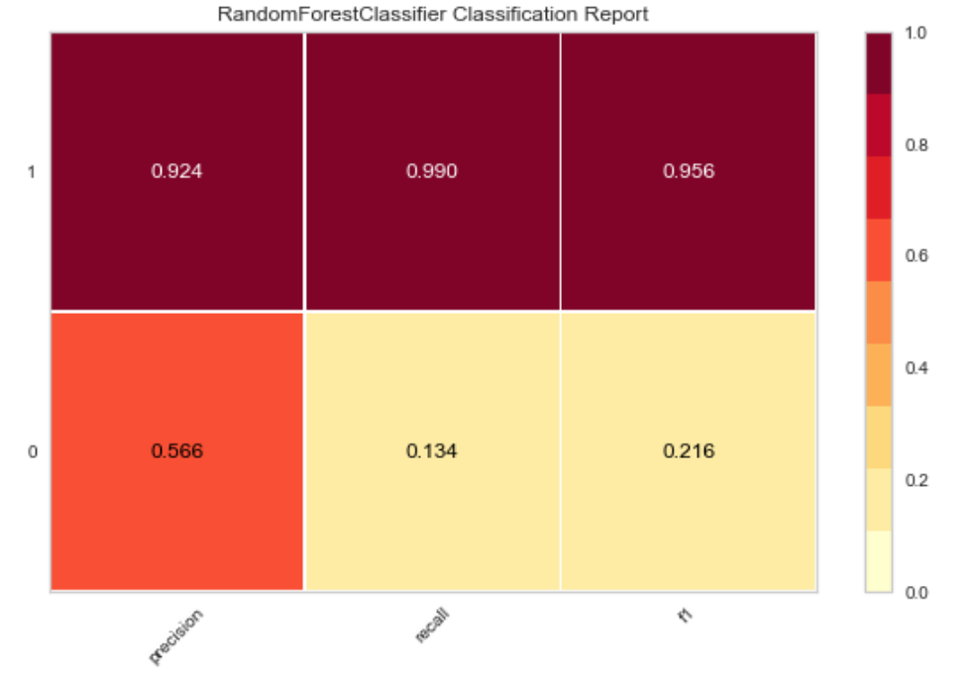
Results
92.4% accuracy for predicting attacks on cloud
56.6% accuracy for predicting attacks on local
The reason might be that the training set for local is much smaller than the one for cloud.

Slide 45
Questions?

